Slide 1
Lecture -22-23
Engineering Mechanics
Principle of Virtual Work

Slide 2
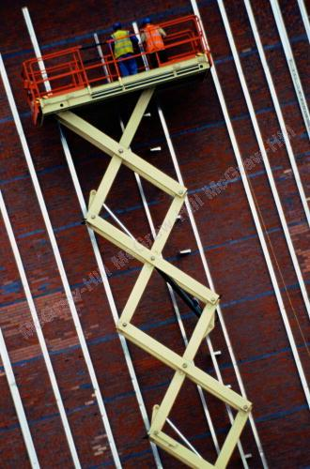
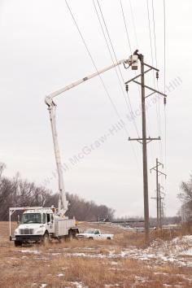
Introduction
In certain cases, for example the analysis of a system of connected rigid bodies, the method of virtual work is a more efficient method than applying equilibrium conditions.

Slide 3
Introduction
Principle of virtual work - if a particle, rigid body, or system of rigid bodies which is in equilibrium under various forces is given an arbitrary virtual displacement, the net work done by the external forces during that displacement is zero.
The principle of virtual work is particularly useful when applied to the solution of problems involving the equilibrium of machines or mechanisms consisting of several connected members.
If a particle, rigid body, or system of rigid bodies is in equilibrium, then the derivative of its potential energy with respect to a variable defining its position is zero.
The stability of an equilibrium position can be determined from the second derivative of the potential energy with respect to the position variable.

Slide 4
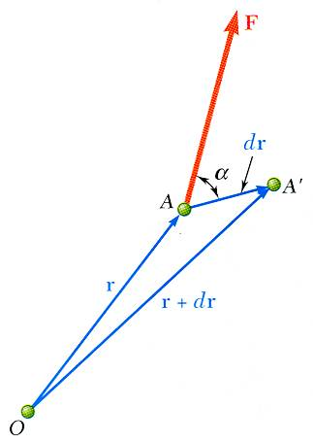
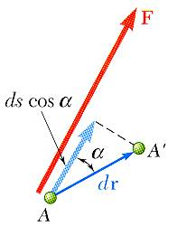
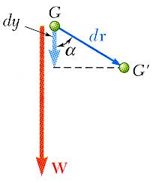
Work of a force
= work of the force corresponding to the displacement
Work of the force during infinitesimal displacement is equal to the product of displacement and the component of force in the direction of displacement. It is a scalar quantity and has a sign. Unit is Nm or Joule.
Work of the force is positive when the direction of force and displacement are the same. For example, work done by force of gravity is negative, when a body moves from lower elevation to higher elevation and vice versa.

Slide 5
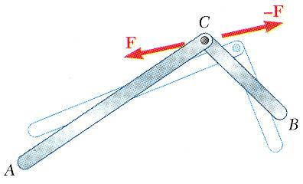
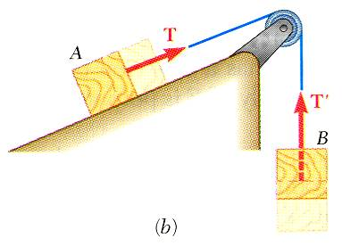
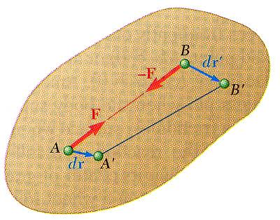
Work of a force
Forces which do no work:
reaction at a frictionless pin due to rotation of a body around the pin
reaction at a frictionless surface due to motion of a body along the surface
weight of a body with cg moving horizontally
friction force on a wheel moving without slipping
Sum of work done by several forces may be zero:
bodies connected by a frictionless pin
bodies connected by an inextensible cord
internal forces holding together parts of a rigid body

Slide 6
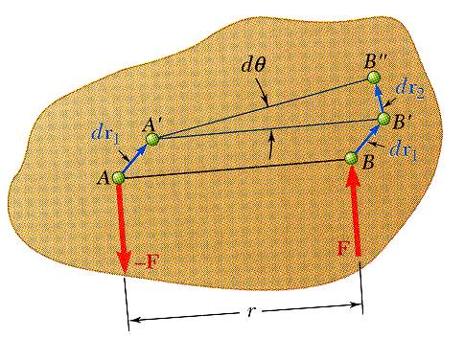
Work of a couple
Small displacement of a rigid body:
translation to A’B’
rotation of B’ about A’ to B”

Slide 7
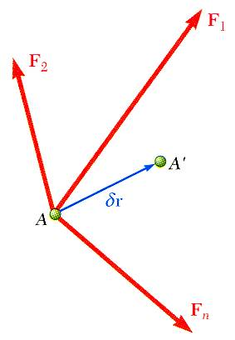
Principle of virtual work
Imagine the small virtual displacement of particle which is acted upon by several forces.
The corresponding virtual work,
Principle of Virtual Work:
If a particle is in equilibrium, the total virtual work of forces acting on the particle is zero for any virtual displacement.
If a rigid body is in equilibrium, the total virtual work of external forces acting on the body is zero for any virtual displacement of the body.
If a system of connected rigid bodies remains connected during the virtual displacement, only the work of the external forces need be considered.

Slide 8
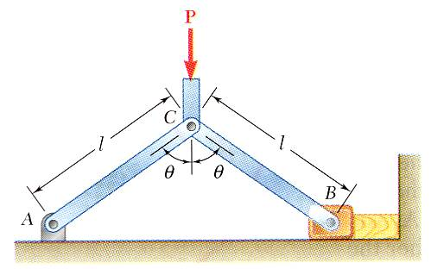
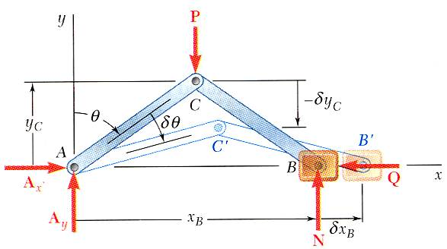
Principle of virtual work
Wish to determine the force of the vice on the block for a given force P.
Consider the work done by the external forces for a virtual displacement δθ. Only the forces P and Q produce nonzero work.
If the virtual displacement is consistent with the constraints imposed by supports and connections, only the work of loads, applied forces, and friction forces need be considered.

Slide 9
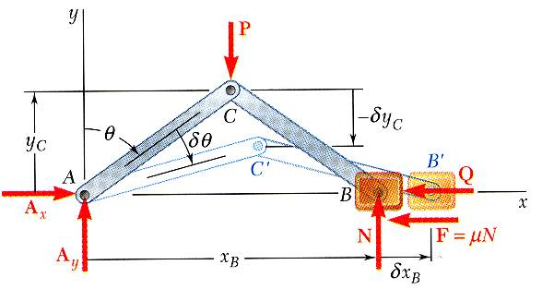
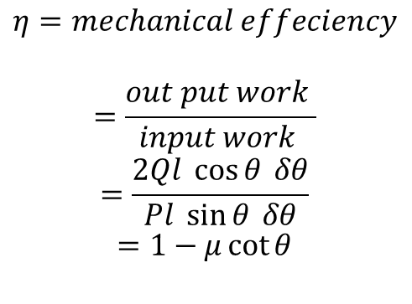
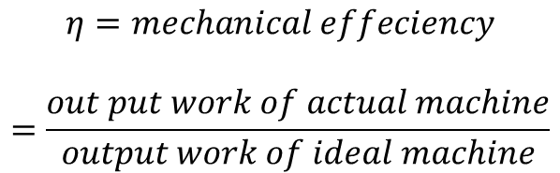
Principle of virtual work
$$η=mechanical effeciency$$
$$=\frac{out put work of actual machine}{output work of ideal machine}$$
$$η=mechanical effeciency$$
$$=\frac{out put work }{input work }$$
$$=\frac{2Ql \cos{θ} δθ}{Pl \sin{θ} δθ}$$
$$=1−μ\cot{θ}$$
For an ideal machine without friction, the output work is equal to the input work.
When the effect of friction is considered, the output work is reduced.

Slide 10









Application of the principle of virtual work
$$Q$$
$$a$$
$$b$$
$$P$$
$$a$$
$$b$$
$$P$$
$$A$$
$$B$$

Slide 11


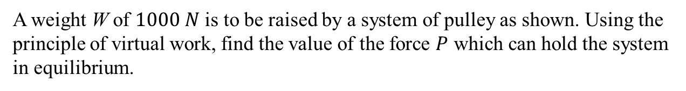
Application of the principle of virtual work
A weight W of $1000 N$ is to be raised by a system of pulley as shown. Using the principle of virtual work, find the value of the force $P$ which can hold the system in equilibrium.
$$P$$
$$W$$

Slide 12









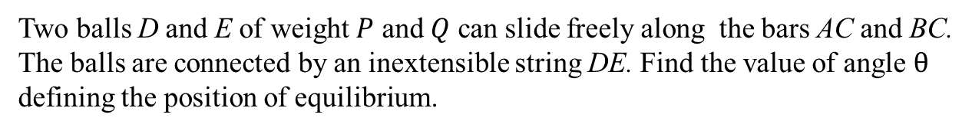




Application of the principle of virtual work
Two balls D and E of weight $P$ and $Q$ can slide freely along the bars AC and BC. The balls are connected by an inextensible string DE. Find the value of angle $θ$ defining the position of equilibrium.
$$C$$
$$P$$
$$Q$$
$$P$$
$${90}^{0}$$
$$Q$$
$$D′$$
$$E$$
$$D$$
$$E′$$
$$A$$
$${30}^{0}$$
$$B$$

Slide 13




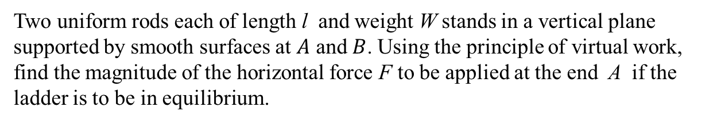









Application of the principle of virtual work
$$B$$
Two uniform rods each of length l and weight W stands in a vertical plane supported by smooth surfaces at $A$ and $B$. Using the principle of virtual work, find the magnitude of the horizontal force F to be applied at the end A if the ladder is to be in equilibrium.
$$∆y$$
$B$’
$$y$$
$$C′$$
$$C$$
$$∆y/2$$
W
W
$$F$$
$$O$$
$A$’
$$A$$
$$x$$
$$∆x$$

Slide 14
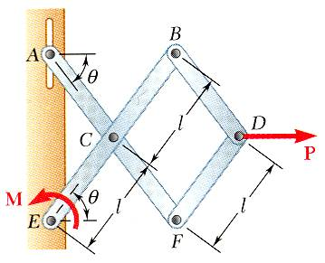
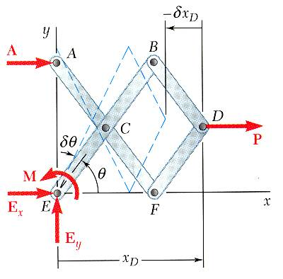
Problem 1
Determine the magnitude of the couple M required to maintain the equilibrium of the mechanism.
SOLUTION:
Apply the principle of virtual work

Slide 15
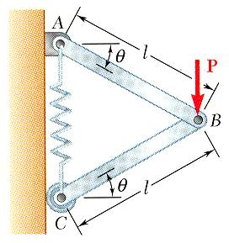
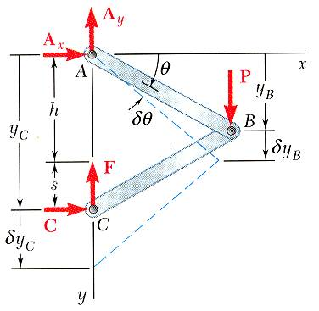
Problem 2
Determine the expressions for θ and for the tension in the spring which correspond to the equilibrium position of the spring. The un-stretched length of the spring is h and the constant of the spring is k. Neglect the weight of the mechanism.
SOLUTION:
Apply the principle of virtual work

Slide 16
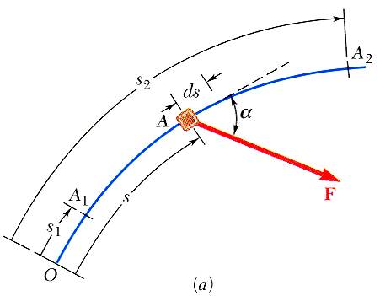
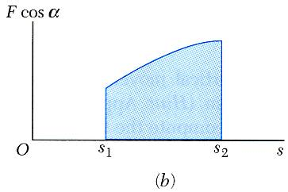
Work of a force during finite displacement
Work of a force corresponding to an infinitesimal displacement,
Work of a force corresponding to a finite displacement,
Similarly, for the work of a couple,

Slide 17
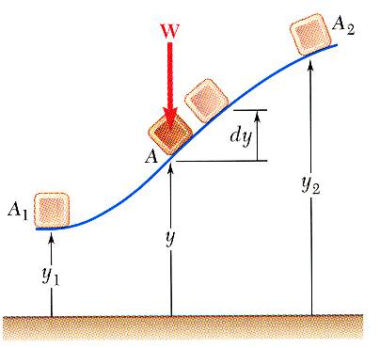
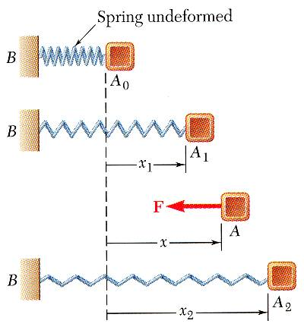
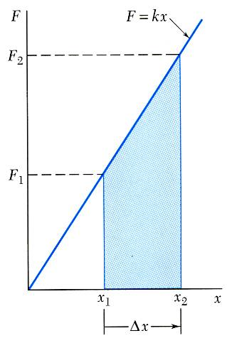
Work of a force during finite displacement
Work of a weight,
Work of a spring,

Slide 18
Potential energy
Work of a weight
The work is independent of path and depends only on
potential energy of the body with respect to the force of gravity
Work of a spring,
potential energy of the body with respect to the elastic force

Slide 19
Potential energy
When the differential work of a force is given by an exact differential,
Forces for which the work can be calculated from a change in potential energy are conservative forces.

Slide 20
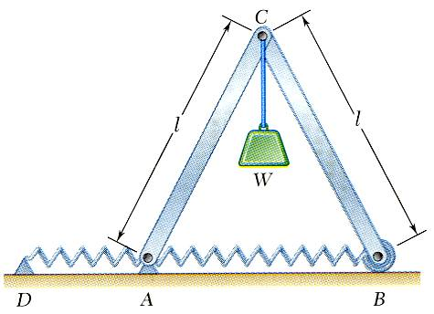
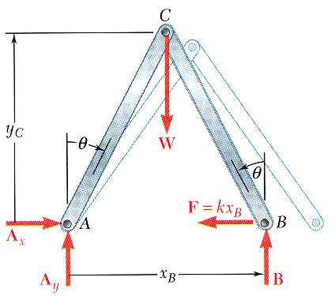
Potential energy and equilibrium
When the potential energy of a system is known, the principle of virtual work becomes
For the structure shown,
At the position of equilibrium,
indicating two positions of equilibrium:
θ = 0, and θ = cos⁻¹ (W/4kl)

Slide 21
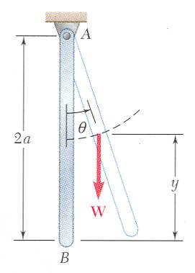
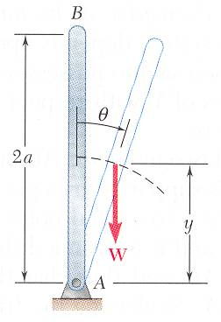
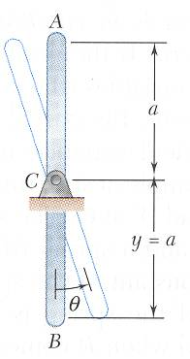
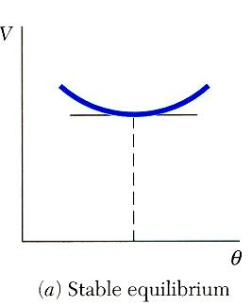
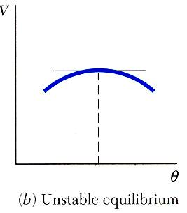
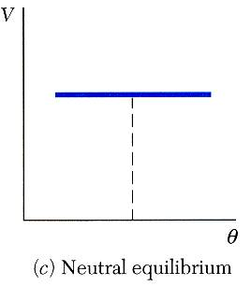
Stability and equilibrium
Must examine higher order derivatives.

Slide 22








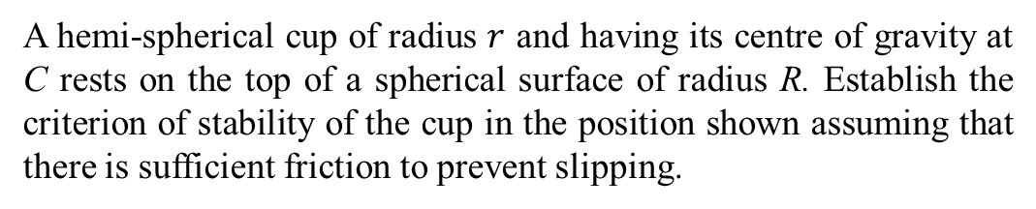




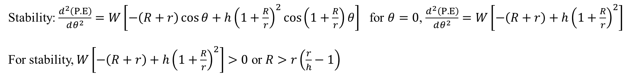


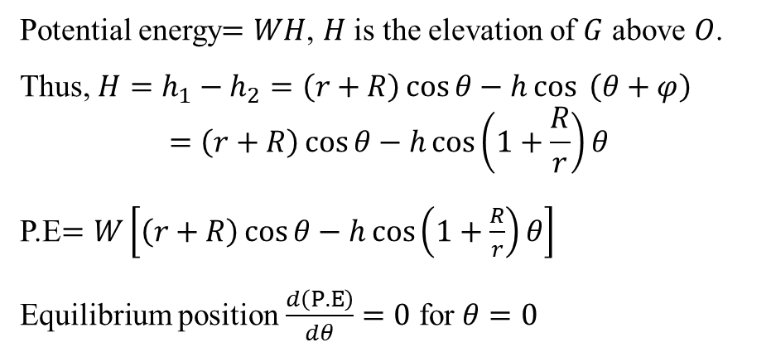






Stability and equilibrium
A hemi-spherical cup of radius $r$ and having its centre of gravity at C rests on the top of a spherical surface of radius R. Establish the criterion of stability of the cup in the position shown assuming that there is sufficient friction to prevent slipping.
$$G$$
$$G′$$
$$φ$$
$$Rθ=rφ$$
$$θ$$
Potential energy$=WH$, $H$ is the elevation of $G$ above $O$.
Thus, $H=h_{1}−h_{2}=\left(r+R\right)\cos{θ}−h\cos{ \left(θ+φ\right)}$
$$=\left(r+R\right)\cos{θ}−h\cos\left(1+\frac{R}{r}\right)θ$$
P.E$=W\left[\left(r+R\right)\cos{θ}−h\cos\left(1+\frac{R}{r}\right)θ\right]$
Equilibrium position $\frac{d\left(P.E\right)}{dθ}=0$ for $θ=0$
$$O$$
$$H$$
$$R$$
$$θ$$
$$h_{1}$$
$$x$$
$$B$$
Stability: $\frac{d^{2}\left(P.E\right)}{dθ^{2}}=W\left[−\left(R+r\right)\cos{θ}+h{\left(1+\frac{R}{r}\right)}^{2}\cos\left(1+\frac{R}{r}\right)θ\right]$ for $θ=0$, $\frac{d^{2}\left(P.E\right)}{dθ^{2}}=W\left[−\left(R+r\right)+h{\left(1+\frac{R}{r}\right)}^{2}\right]$
For stability, $W\left[−\left(R+r\right)+h{\left(1+\frac{R}{r}\right)}^{2}\right]>0$ or $R>r\left(\frac{r}{h}−1\right)$
$$A′$$
$$A$$
$$O_{1}$$
$$h_{2}$$
$$h$$
$$r$$
$$W$$
$$O_{1}$$

Slide 23




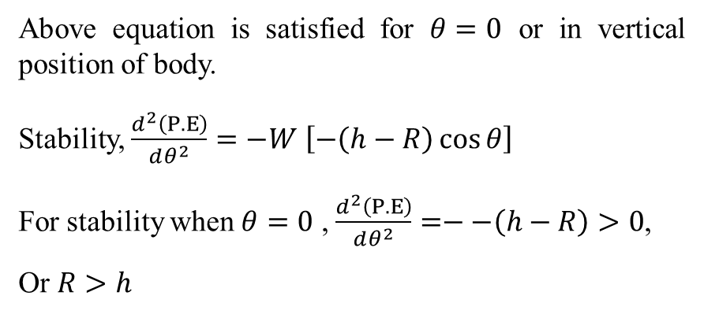



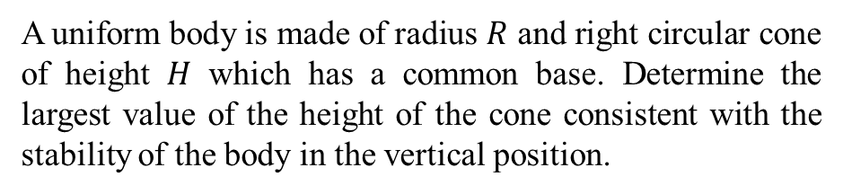






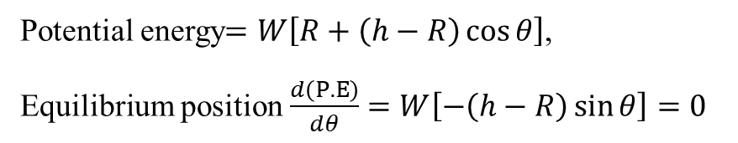



Stability and equilibrium
A uniform body is made of radius $R$ and right circular cone of height $H$ which has a common base. Determine the largest value of the height of the cone consistent with the stability of the body in the vertical position.
Potential energy$=W\left[R+\left(h−R\right)\cos{θ}\right]$,
Equilibrium position $\frac{d\left(P.E\right)}{dθ}=W\left[−\left(h−R\right)\sin{θ}\right]=0$
$$H$$
$$C_{2}$$
$$W_{2}$$
$$h−R$$
$$C$$
$$θ$$
$$\left(h−R \right)\cos{θ}$$
Equilibrium position $\frac{d\left(P.E\right)}{dθ}=0$ for $θ=0$
$$C$$
$$θ$$
$$R$$
$$R$$
Above equation is satisfied for $θ=0$ or in vertical position of body.
Stability, $\frac{d^{2}\left(P.E\right)}{dθ^{2}}=−W$ $\left[−\left(h−R\right)\cos{θ}\right]$
For stability when $θ=0$ , $\frac{d^{2}\left(P.E\right)}{dθ^{2}}=−−\left(h−R\right)>0$,
Or $R>h$
$$R$$
$$h$$
$$C_{1}$$
$$W_{1}$$

Slide 24
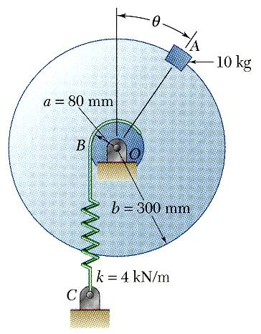
Example
SOLUTION:
Derive an expression for the total potential energy of the system.
Determine the positions of equilibrium by setting the derivative of the potential energy to zero.
Evaluate the stability of the equilibrium positions by determining the sign of the second derivative of the potential energy.
Knowing that the spring BC is unstretched when θ = 0, determine the position or positions of equilibrium and state whether the equilibrium is stable, unstable, or neutral.
?

Slide 25
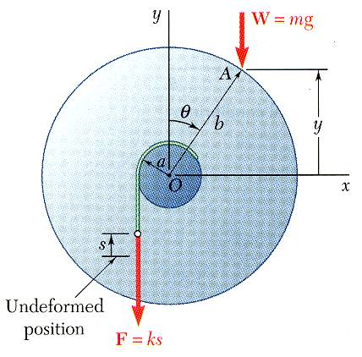
Example
SOLUTION:
Derive an expression for the total potential energy of the system.
Determine the positions of equilibrium by setting the derivative of the potential energy to zero.

Slide 26
Example
Evaluate the stability of the equilibrium positions by determining the sign of the second derivative of the potential energy.
at θ = 0:
unstable
at θ = 51.7º:
stable

Slide 27
Acknowledgement
NPTEL lectures on Engineering Mechanics
Beer & Johnston, Vector Mechanics for Engineers
Meriam & Kraige, Engineering Mechanics
Problems taken from internet sources
Timoshenko & Young, Engineering Mechanics
S S Rattan, Theory of Machine

